Slide 1


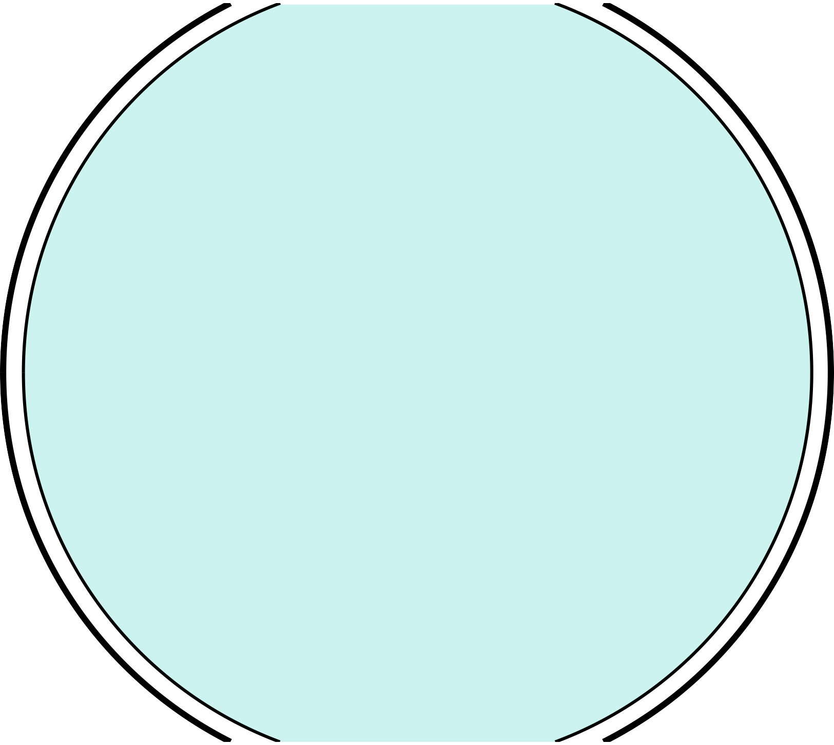









Georgia’s
SS8G1c
© 2015 Brain Wrinkles

Slide 2

Standards
SS8G1 The student will describe Georgia with regard to physical features and location.
c. Locate and evaluate the importance of key physical features on the development of Georgia; include the Fall Line, Okefenokee Swamp, Appalachian Mountains, Chattahoochee and Savannah Rivers, and barrier islands.
© 2015 Brain Wrinkles

Slide 3
Teacher Directions – CLOZE Notes
The next pages are handouts for the students to use for note-taking during the presentation. (Print front to back for one page.)
Check the answers as a class after the presentation.
© 2015 Brain Wrinkles

Slide 4





Physical Features
There are many different in the Georgia.
Physical features include bodies of water, deserts,
, and other landforms.
They are ; they are not man- made.
Fall Line
The Fall Line is about twenty miles wide and separates the
region.
It marks the part of the state where the elevation begins to
towards sea level.
This causes water to at an increased rate.
In the state’s early days, like Columbus, Macon, Milledgeville, and Augusta along the Fall Line
rivers.
These cities began as places where
from boats to wagons and trains.
Today, the Fall Line features some of the state’s most beautiful waterfalls.
Okefenokee Swamp
The Okefenokee Swamp is located in the
of Georgia, and it is one of the largest fresh water swamps in North America.
It covers roughly of the Coastal Plains region.
Its name comes from a Seminole word meaning,
“ _ ”.
Water in the swamp averages between
, and there is unstable, marshy ground beneath it.
The Okefenokee Swamp is home to
of plants and animals.
In 1937, created the Okefenokee National Wildlife Refuge, so the swamp is now
.
© 2015 Brain Wrinkles

Slide 5




Appalachian Mountains
of the Appalachian Mountain range extends into Georgia.
The southern end of the chain lies within the
.
These mountains are Georgia’s , with more than 80 inches of rainfall every year.
In 1828, in this area of the mountain range and put the town of Dahlonega on the map.
Today, tourists visit the Appalachian Mountains to enjoy the
and recreational activities.
Chattahoochee River
The Chattahoochee River begins in the Blue Ridge Mountains and
toward Alabama and the Gulf of Mexico.
The Chattahoochee is an for Georgia, as well as for Alabama and Florida.
In the past, cities along the river used it as a source of
and as a means of transportation.
Today, many man-made lakes harness water from the river for
, drinking water, and flood control.
It is also used for like kayaking, canoeing, and fishing.
Savannah River
The Savannah River begins in the foothills of the Appalachian Mountains and is the natural boundary between
.
It flows southwest toward Savannah and empties into the
.
It’s important for shipping and trade because its
make it possible for large ships to
navigate.
Barrier Islands
Barrier Islands are located along Georgia’s coastline and form a barrier between the .
These islands protect the mainland from much of the ocean
that would otherwise erode the coast.
In Georgia’s early history, forts were built on the islands to
.
Today, some of the islands, like St Simons, Tybee, and Jekyll, are
popular vacation .
Other barrier islands are and wilderness sanctuaries, and cannot be destroyed by manmade developments.
© 2015 Brain Wrinkles

Slide 6




Physical Features
There are many different physical features in the Georgia.
Physical features include bodies of water, deserts,
mountain ranges, and other landforms.
They are created by nature; they are not man-made.
Fall Line
The Fall Line is about twenty miles wide and separates the Piedmont region from the Coastal Plain region.
It marks the part of the state where the elevation begins to drastically drop towards sea level.
This causes water to run down hill at an increased rate.
In the state’s early days, Georgians built cities like Columbus, Macon, Milledgeville, and Augusta along the Fall Line rivers.
These cities began as places where goods were transferred from boats to wagons and trains.
Today, the Fall Line features some of the state’s most beautiful waterfalls.
Okefenokee Swamp
The Okefenokee Swamp is located in the southeast corner of Georgia, and it is one of the largest fresh water swamps in North America.
It covers roughly 700 square miles of the Coastal Plains region.
Its name comes from a Seminole word meaning, “land of the trembling earth”.
Water in the swamp averages between 2 and 4 feet deep, and there is unstable, marshy ground beneath it.
The Okefenokee Swamp is home to more than 1,000 types of plants and animals.
In 1937, President Roosevelt created the Okefenokee National Wildlife Refuge, so the swamp is now protected land.
© 2015 Brain Wrinkles

Slide 7



Appalachian Mountains
Nearly 100 miles of the Appalachian Mountain range extends into Georgia.
The southern end of the chain lies within the Blue Ridge region.
These mountains are Georgia’s highest and wettest areas, with more than 80 inches of rainfall every year.
In 1828, gold was discovered in this area of the mountain range and put the town of Dahlonega on the map.
Today, tourists visit the Appalachian Mountains to enjoy the region’s
beautiful views and recreational activities.
Chattahoochee River
The Chattahoochee River begins in the Blue Ridge Mountains and flows southwest toward Alabama and the Gulf of Mexico.
The Chattahoochee is an important source of water for Georgia, as well as for Alabama and Florida.
In the past, cities along the river used it as a source of power for mills and as a means of transportation.
Today, many man-made lakes harness water from the river for hydroelectricity, drinking water, and flood control.
It is also used for recreational activities like kayaking, canoeing, and fishing.
Savannah River
The Savannah River begins in the foothills of the Appalachian Mountains and is the natural boundary between Georgia and South Carolina.
It flows southwest toward Savannah and empties into the Atlantic Ocean.
It’s important for shipping and trade because its deep waters and
width make it possible for large ships to navigate.
Barrier Islands
Barrier Islands are located along Georgia’s coastline and form a barrier between the mainland and the Atlantic Ocean.
These islands protect the mainland from much of the ocean wind, waves, and currents that would otherwise erode the coast.
In Georgia’s early history, forts were built on the islands to protect the state’s coast.
Today, some of the islands, like St Simons, Tybee, and Jekyll, are popular vacation destinations for tourists.
Other barrier islands are protected wildlife reserves and wilderness sanctuaries, and cannot be destroyed by manmade developments.
© 2015 Brain Wrinkles

Slide 8
Teacher Directions – Foldable
The next two pages are for an Interactive Foldable. (*This is an alternative way for your students to take notes if you do not want to use the CLOZE notes.)
Print out the foldable pages for each student.
The students will cut the template out along the thick outside lines.
Next, they will cut along the thin lines that divide each word, stopping at the gray rectangle.
They should attach the side of the template (gray rectangle) to their notebooks.
They will now be able to open up each flap and write the definitions underneath.
*If time allows, have students color the flaps.
© 2015 Brain Wrinkles

Slide 9


 | Fall Line
 | Okefenokee Swamp
 | Appalachian ftountains
© 2015 Brain Wrinkles

Slide 10
 | Chattahoochee River
 | Savannah River
 | Barrier Islands
© 2015 Brain Wrinkles

Slide 11





Fall Line | Area where the Piedmont and Coastal Plain meet that features a rapid drop in elevation and many waterfalls; many of GA’s early cities are located along the Fall Line
Okefenokee Swamp | One of the nation’s largest swamps; 700 square mile fresh water wetland in the Coastal Plain; home to hundreds of species of plants and animals
Appalachian ftountains | Southern tip of chain lies in Blue Ridge region; nearly 100 miles are in Georgia
Chattahoochee River | Major river that forms part of border between GA and AL; important water source for GA, AL, & FL; provides hydroelectricity, drinking water, recreation, & flood control
Savannah River | Major river that forms most of the GA-SC border; important for shipping and trade because it is deep and wide enough for large ships; also provides drinking water, recreation, and a source of power
Barrier Islands | Islands that line Georgia’s coast; protect the mainland form erosion

Slide 12







There are many different physical features in the Georgia.
Physical features include bodies of water, deserts, mountain ranges, and other landforms.
They are created by nature; they are not man- made.

Slide 13
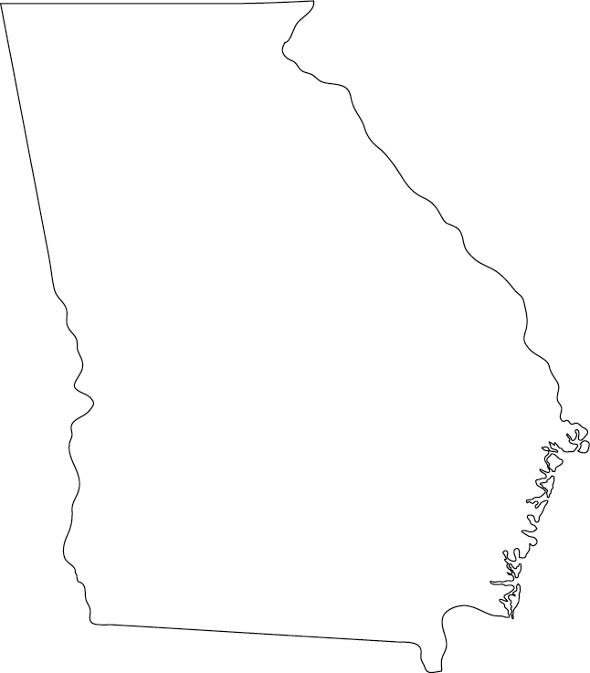
Appalachian ftountains
Chattahoochee River
Fall Line
Savannah River
Barrier
Islands
Okefenokee
Swamp

Slide 14



The Fall Line is about twenty miles wide and separates the Piedmont region from the Coastal Plain region.
It marks the part of the state where the elevation begins to drastically drop towards sea level.
This causes water to run down hill at an increased rate.

Slide 15
Fall Line

Slide 16

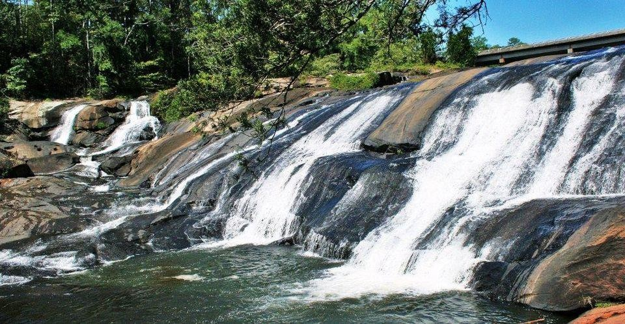

Slide 17
In the state’s early days, Georgians built cities like Columbus, Macon, Milledgeville, and Augusta along the Fall Line rivers.
These cities began as places where goods were transferred from boats to wagons and trains.
Today, the Fall Line features some of the state’s most beautiful waterfalls.

Slide 18

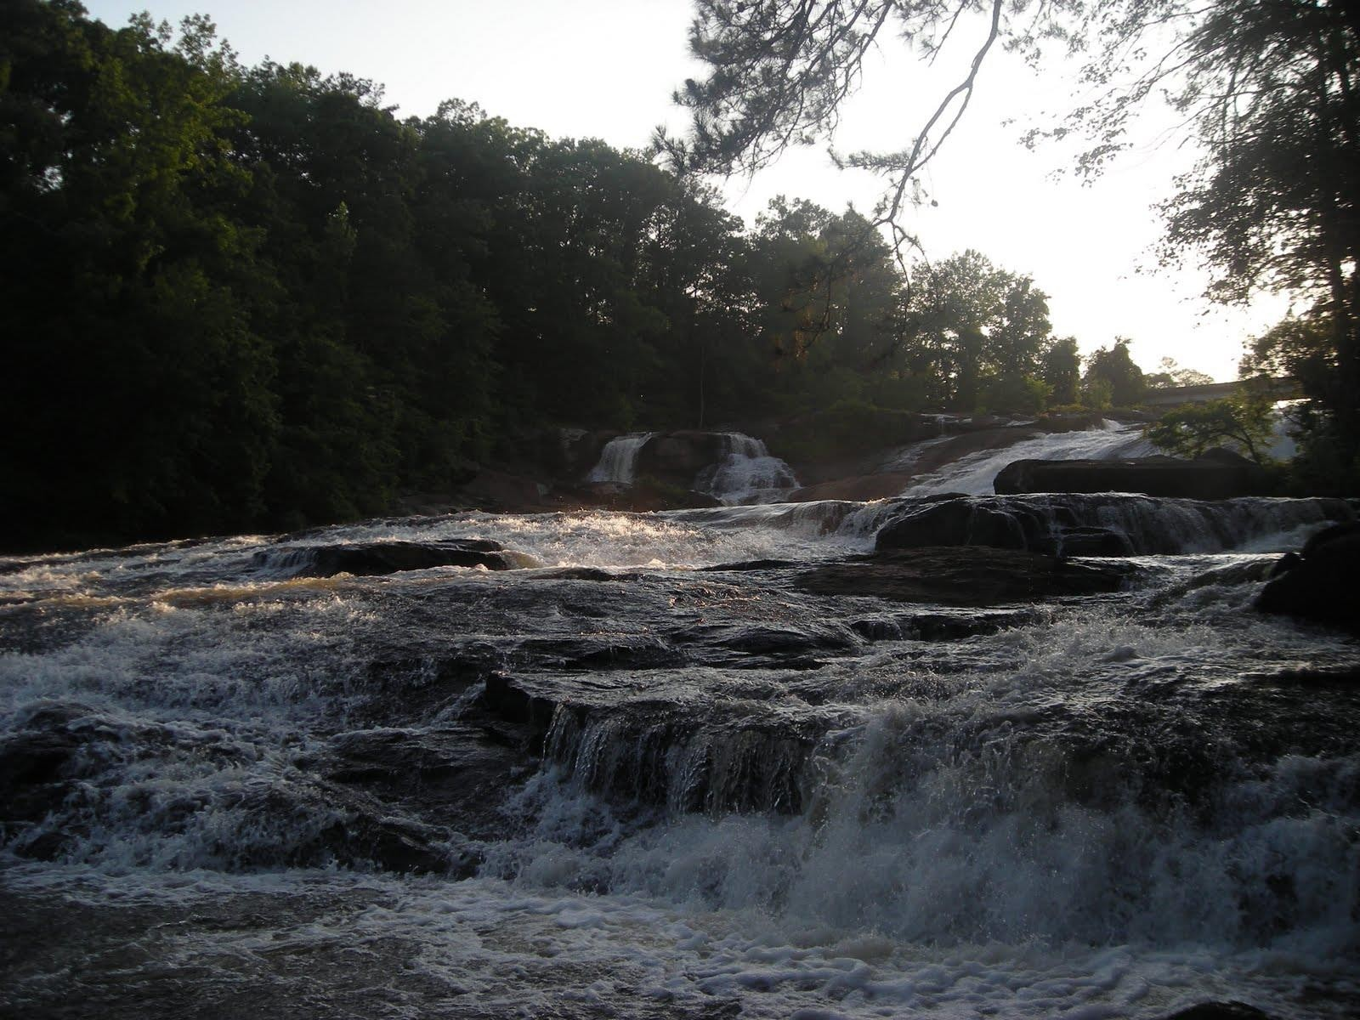

Slide 19



The Okefenokee Swamp is located in the southeast corner of Georgia, and it is one of the largest fresh water swamps in North America.
It covers roughly 700 square miles of the Coastal Plains region.
Its name comes from a Seminole word meaning, “land of the trembling earth”.

Slide 20
Okefenokee
Swamp

Slide 21

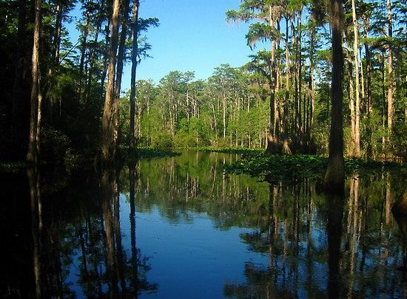

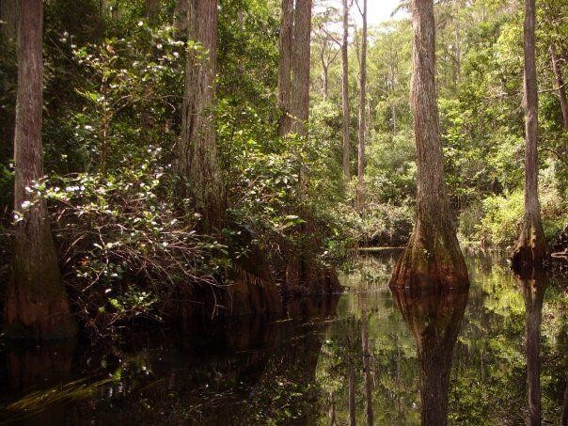

Slide 22
Water in the swamp averages between 2 and 4 feet deep, and there is unstable, marshy ground beneath it.
The Okefenokee Swamp is home to more than 1,000 types of plants and animals.
In 1937, President Roosevelt created the Okefenokee National Wildlife Refuge, so the swamp is now protected land.

Slide 23

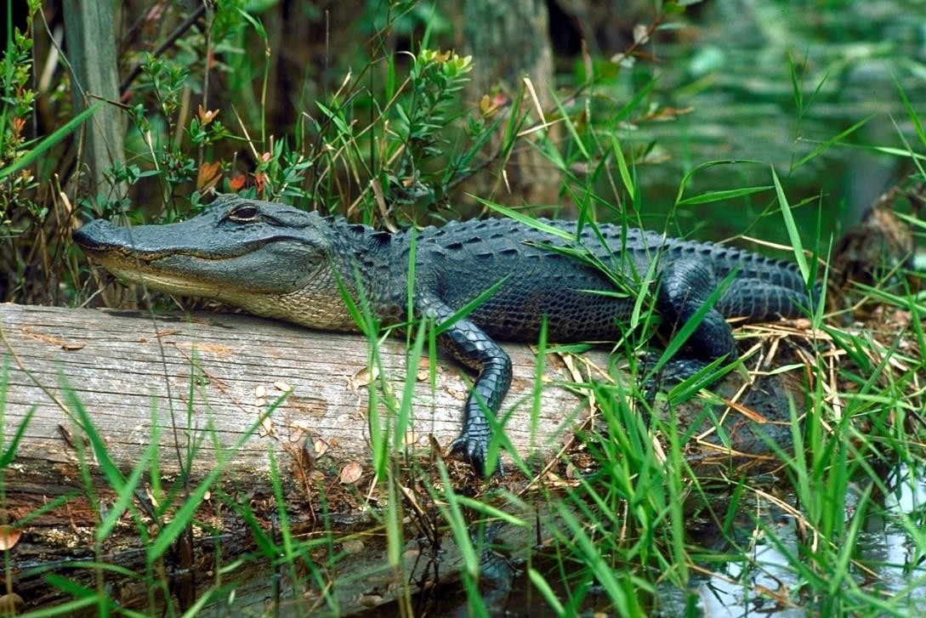

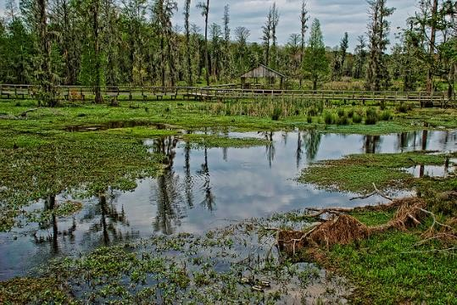

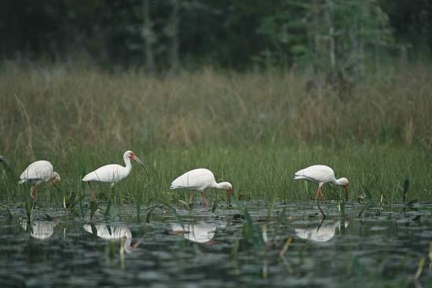

Slide 24



Nearly 100 miles of the Appalachian Mountain range extends into Georgia.
The southern end of the chain lies within the Blue Ridge region.
These mountains are Georgia’s highest and wettest areas, with more than 80 inches of rainfall every year.

Slide 25
Appalachian ftountains

Slide 26

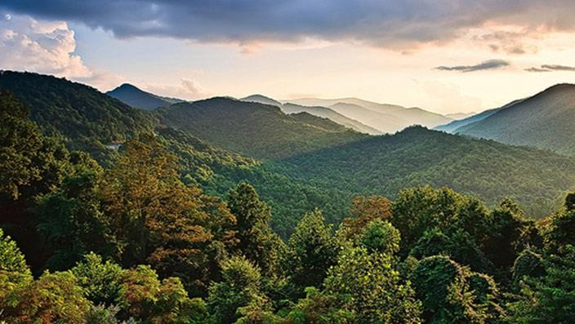

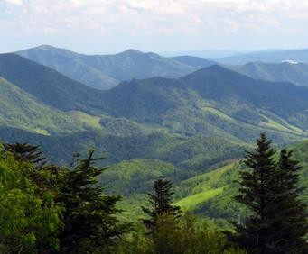

Slide 27
In 1828, gold was discovered in this area of the mountain range and put the town of Dahlonega on the map.
Today, tourists visit the Appalachian Mountains to enjoy the region’s beautiful views and recreational activities.

Slide 28

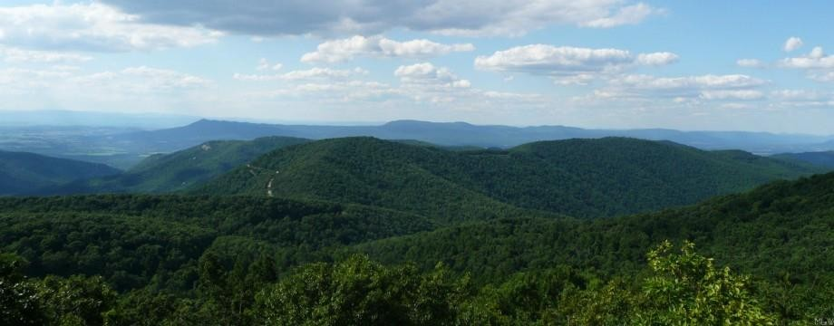

Slide 29

The Chattahoochee River begins in the Blue Ridge Mountains and flows southwest toward Alabama and the Gulf of Mexico.
The Chattahoochee is an important source of water for Georgia, as well as for Alabama and Florida.

Slide 30
Chattahoochee River

Slide 31
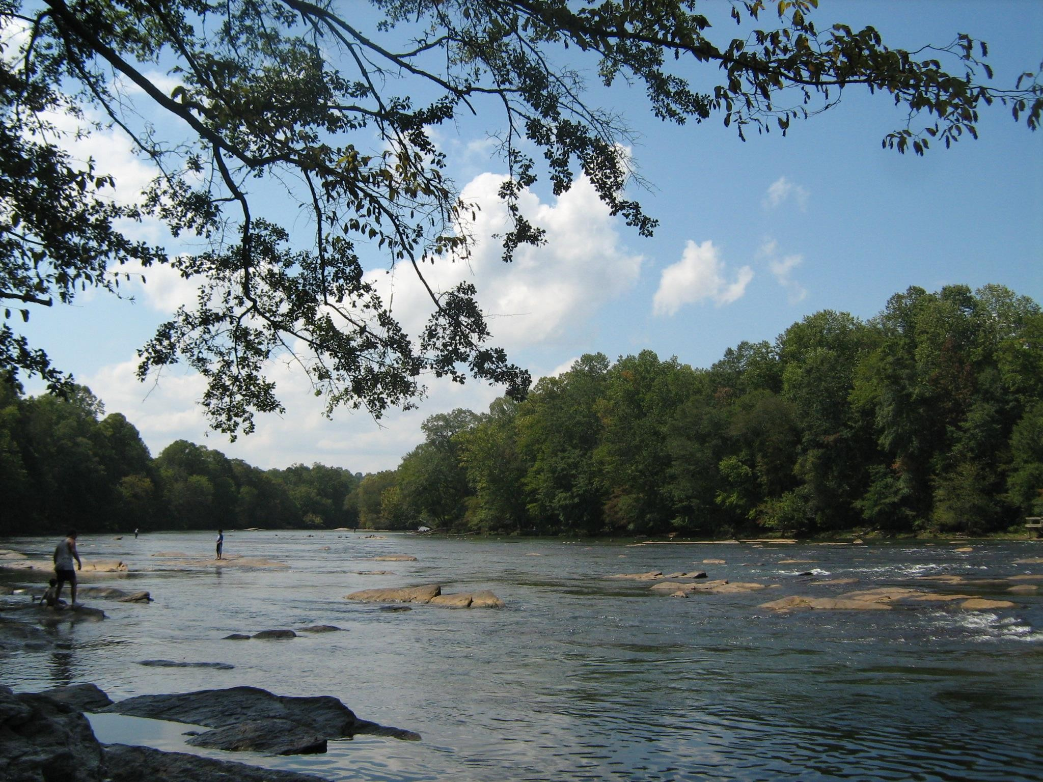

Slide 32
In the past, cities along the river used it as a source of power for mills and as a means of transportation.
Today, many man-made lakes harness water from the river for hydroelectricity, drinking water, and flood control.
It is also used for recreational activities like kayaking, canoeing, and fishing.

Slide 33

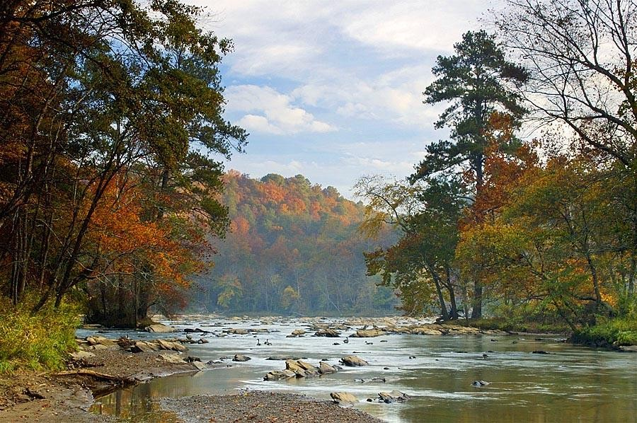

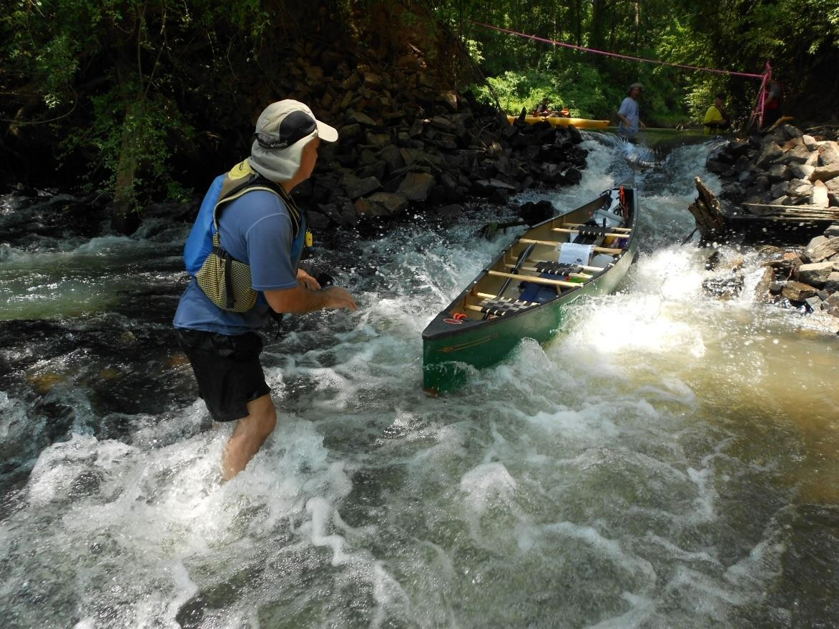

Slide 34






The Savannah River begins in the foothills of the Appalachian Mountains and is the natural boundary between Georgia and South Carolina.
It flows southwest toward Savannah and empties into the Atlantic Ocean.
It’s important for shipping and trade because its deep waters and width make it possible for large ships to navigate.

Slide 35
Savannah River

Slide 36

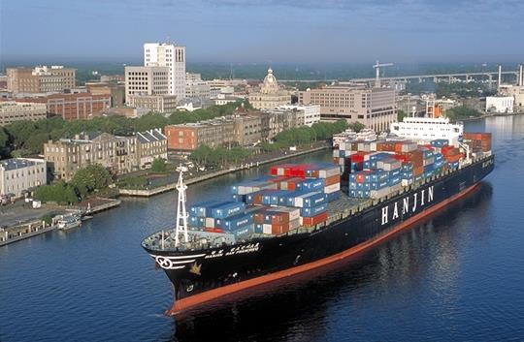

Slide 37



Barrier Islands are located along Georgia’s coastline and form a barrier between the mainland and the Atlantic Ocean.
These islands protect the mainland from much of the ocean wind, waves, and currents that would otherwise erode the coast.
In Georgia’s early history, forts were built on the islands to protect the state’s coast.

Slide 38
Barrier
Islands

Slide 39

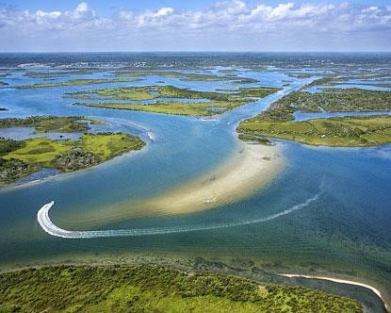

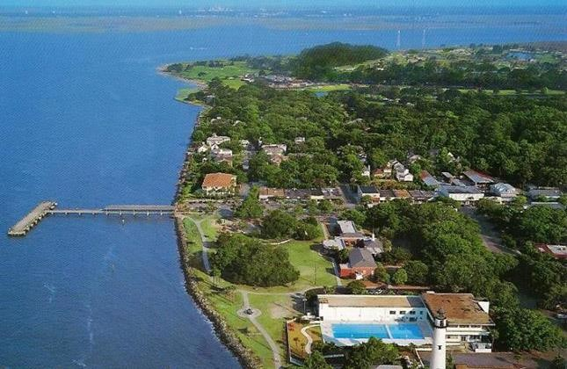
St Simons Island

Slide 40
Today, some of the islands, like St Simons, Tybee, and Jekyll, are popular vacation destinations for tourists.
Other barrier islands are protected wildlife reserves and wilderness sanctuaries, and cannot be destroyed by manmade developments.

Slide 41


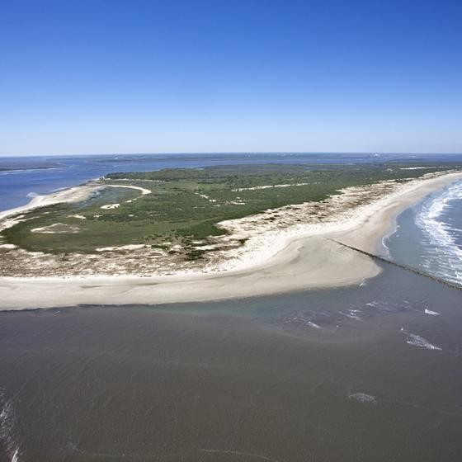
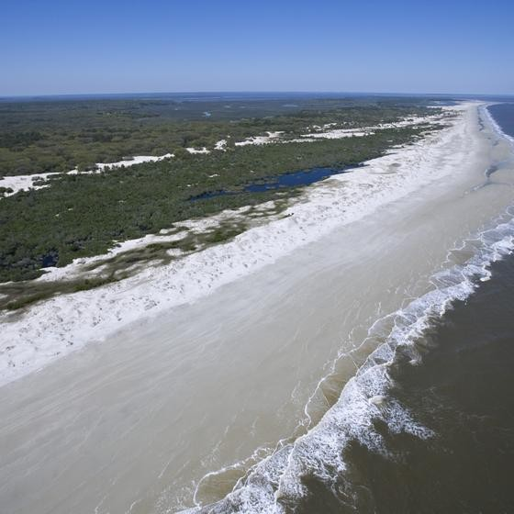
Cumberland Island

Slide 42
Appalachian ftountains
Chattahoochee River
Fall Line
Savannah River
Barrier
Islands
Okefenokee
Swamp

Slide 43
Teacher Info – Physical Features Chart
Print off the Physical Features Chart for each student.
The students will complete the chart with the location, description, and illustration of each physical feature.
*Print front-to-back to save ink & paper!

Slide 44


Directions: Complete the chart below with information about important physical features in Georgia. You will need to include a description, the location, and an illustration for each feature.
Fall Line Location: Description: | Okefenokee Swamp Location: Description:
Appalachian ftountains Location: Description: | Chattahoochee River Location: Description:
© 2015 Brain Wrinkles

Slide 45
Savannah River
Barrier Islands
Location:
Location:
Description:
Description:
© 2015 Brain Wrinkles

Slide 46

Teacher Info – Georgia ftap
Print off the GA’s Physical Features map for each student.
The students will label and color the 6 physical features on the map.
© 2015 Brain Wrinkles

Slide 47
GA’s Physical Features
Directions: Label and color each physical feature on the map: Chattahoochee River, Savannah River, Okefenokee Swamp, Appalachian Mountains, Barrier Islands, and Fall Line.
© 2015 Brain Wrinkles

Slide 48
Teacher Info – Souvenir Suitcase
Print off the Souvenir Suitcase handout for each student.
The students will imagine that they took a trip to all 6 places mentioned in this presentation. They will draw a souvenir inside of the suitcase to represent each place.
Underneath each souvenir, they should write where it’s from & how it’s significant to the place.
© 2015 Brain Wrinkles

Slide 49






Directions: Imagine that you are on a tour that stops at each of the key features in Georgia. Draw a souvenir that you have collected at each place. Underneath your pictures, please write where the souvenir is from and how it is significant to the place.
© 2015 Brain Wrinkles

Slide 50
Teacher Directions – Design A Plate
Have the students design a plate that showcases the physical features from this presentation.
The design should include symbols or facts that relate to the physical features.
In the textbox, they will write a description that explains the symbols used in the plate’s design.
© 2015 Brain Wrinkles

Slide 51



Directions: Design a plate that showcases all of the important physical features that we have studied. Make sure that your plate’s design includes symbols and illustrations that represent the four features. In the textbox, you will explain your plate’s design and the significance of the symbols.
Plate’s Description:
© 2015 Brain Wrinkles

Slide 52
Teacher Info – GA Postcard
Print off the Famous Place Postcard for each student.
The students will write a short note to their family describing one of the important places in Georgia’s geography (as if they are there).
On the front, they will draw an illustration of the place and include a short greeting.
If time allows, the students can cut out the cards and tape the front to the back like an actual postcard.
© 2015 Brain Wrinkles

Slide 53
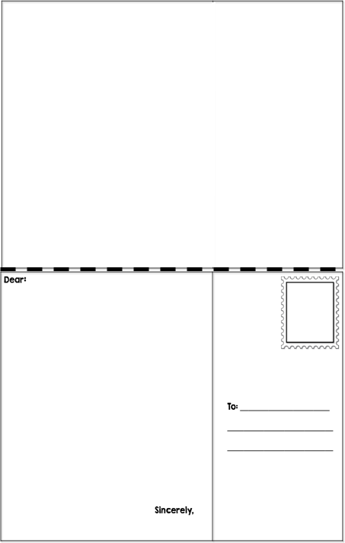
Famous Place Postcard
Directions: Write a short note to your family describing one of the important places that we have studied. Be sure to describe where the place is located and why it is famous. On the front, draw an illustration of the place and include a short greeting.
Front
Back
© 2015 Brain Wrinkles

Slide 54
Teacher Directions – fty Name Is…
Have students write 3-5 “clues” about one of Georgia’s physical features from the lesson (but don’t write the name of the feature).
They will also draw a quick sketch of the feature inside of the box. (Color, if time).
The next day, begin class by having students share their clues and have their peers guess the place. You can do this in partners, groups, or with the entire class.
© 2015 Brain Wrinkles

Slide 55




Directions: On the name tag below, write 3-5 clues about one of Georgia’s physical features. Don’t write the feature’s name because your classmates are going to guess what it is based on your description! Inside of the textbox, draw and color an illustration of the feature.
© 2015 Brain Wrinkles

Slide 56
Teacher Info – Fieldtrip Wish List Ticket Out the Door
Have students write a quick note to persuade you to take them on a “fieldtrip” to one of the places or features from this lesson. They should include at least 3 reasons why the class should visit that feature.
If time, they can draw an illustration to accompany the note.
© 2015 Brain Wrinkles

Slide 57






Wouldn’t it be awesome to take a fieldtrip to visit one of the physical features that we’ve studied? Write me a note to try and convince me to take your class there. Include at least THREE reasons why we should visit that place/feature. Also, draw an illustration to go with your note.
Wouldn’t it be awesome to take a fieldtrip to visit one of the physical features that we’ve studied? Write me a note to try and convince me to take your class there. Include at least THREE reasons why we should visit that place/feature.
Also, draw an illustration to go with your note.
From the Desk of…
From the Desk of…
© 2015 Brain Wrinkles
© 2015 Brain Wrinkles

Slide 58









Thank you so much for downloading this file. I sincerely hope you find it helpful and that your students learn a lot from it! I look forward to reading your feedback in my store.
If you like this file, you might want to check out some of my other products that teach social studies topics in creative, engaging, and hands-on ways.
Best of luck to you this school year,
Ansley at Brain Wrinkles
© 2015 Brain Wrinkles

Slide 59








© 2015 Brain Wrinkles. Your download includes a limited use license from Brain Wrinkles. The purchaser may use the resource for personal classroom use only. The license is not transferable to another person. Other teachers should purchase their own license through my store.
This resource is not to be used:
By an entire grade level, school, or district without purchasing the proper number of licenses. For school/district licenses at a discount, please contact me.
As part of a product listed for sale or for free by another individual.
On shared databases.
Online in any way other than on password-protected website for student use only.
© Copyright 2015. Brain Wrinkles. All rights reserved. Permission is granted to copy pages specifically designed for student or teacher use by the original purchaser or licensee. The reproduction of any other part of this product is strictly prohibited. Copying any part of this product and placing it on the Internet in any form (even a personal/classroom website) is strictly forbidden. Doing so makes it possible for an Internet search to make the document available on the Internet, free of charge, and is a violation of the Digital Millennium Copyright Act (DMCA).
Clipart, fonts, & digital papers for this product were purchased from:
Thank you,
Ansley at Brain Wrinkles
© 2015 Brain Wrinkles

